Slide 1
Servlets Session

Slide 2
Servlets Cookies
HTTP is a "stateless" protocol which means each time a client retrieves a Web page, the client opens a separate connection to the Web server and the server automatically does not keep any record of previous client request.
Servlet provides HttpSession Interface which provides a way to identify a user across more than one page request or visit to a Web site and to store information about that user.

Slide 3
Session methods
HttpSession session = request.getSession();
public Object getAttribute(String name)
public String getId()
public long getLastAccessedTime()
public int getMaxInactiveInterval()
public void invalidate()
public void removeAttribute(String name)

Slide 4
Key code
HttpSession session = request.getSession(true);
Date createTime = new Date(session.getCreationTime());
Date lastAccessTime = new Date(session.getLastAccessedTime());
String title = "Welcome Back to my website";
Integer visitCount = new Integer(0);
String visitCountKey = new String("visitCount");
String userIDKey = new String("userID");
String userID = new String("ABCD");

Slide 5
Key code
if (session.isNew()) {
title = "Welcome to my website";
session.setAttribute(userIDKey, userID);
} else {
visitCount = (Integer)session.getAttribute(visitCountKey);
visitCount = visitCount + 1;
userID = (String)session.getAttribute(userIDKey);
}
session.setAttribute(visitCountKey, visitCount)

Slide 6
Key html code
"<tr>
<td>id</td>\n" +
<td>" + session.getId() + "</td>
</tr>
tr> <td>Creation Time</td>
<td>" + createTime + " </td> </tr>
<tr>
<td>Time of Last Access</td>\n" +
<td>" + lastAccessTime + " </td>
</tr>
<tr>
<td>User ID</td>
<td>" + userID + " </td> </tr>
<tr>"
<td>Number of visits</td>
<td>" + visitCount + "</td></tr>
"</table>\n" );

Slide 7
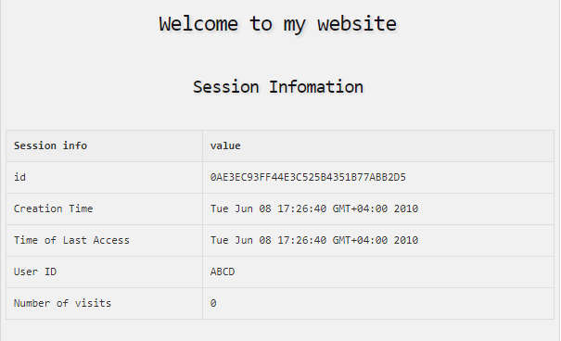
output

